Slide 1


S4D400 - Introduction to abap programming on s/4hana
Anubhav Oberoy

Slide 2

Agenda – Day 4
SQL Query Continue
- Built-in SQL Functions
- FOR ALL Entries
- Joins and Sub-Queries
- Aggregate functions
- Working with DB DML
- Debugging
Calling Reusable Procedures
- Modularization Techniques - Sub Routines and External Sub Routines
- Function Modules
- Using Standard SAP Modules
- Debugging
Creating and Using Classes
- Introduction to Object Oriented programming
- Creating Class
- Modularize Class Code
- Create Object of class using old and new syntax
- Type Casting
- Debugging

Slide 3
SQL Functions
SQL provides many built-in functions to perform operations on data. These functions are useful while performing mathematical calculations, string concatenations, sub-strings etc. SQL functions are divided into two categories,
Aggregate Functions – which are used to aggregate/group data
Scalar Functions – performed to execute single operational output

Slide 4
Select FOR ALL ENTRIES
The WHERE clause of the SELECT statement has a special variant that allows you to derive conditions from the lines and columns of an internal table:
SELECT ... FOR ALL ENTRIES IN <itab> WHERE <cond> ...
<cond> may be formulated as described above. If you specify a field of the internal table <itab> as an operand in a condition, you address all lines of the internal table. The comparison is then performed for each line of the internal table. For each line, the system selects the lines from the database table that satisfy the condition.
The result set of the SELECT statement is the union of the individual selections for each line of the internal table. Duplicate lines are automatically eliminated from the result set. If <itab> is empty, the addition FOR ALL ENTRIES is disregarded, and all entries are read.
The internal table <itab> must have a structured line type, and each field that occurs in the condition <cond> must be compatible with the column of the database with which it is compared. Do not use the operators LIKE, BETWEEN, and IN in comparisons using internal table fields. You may not use the ORDER BY clause in the same SELECT statement.

Slide 5
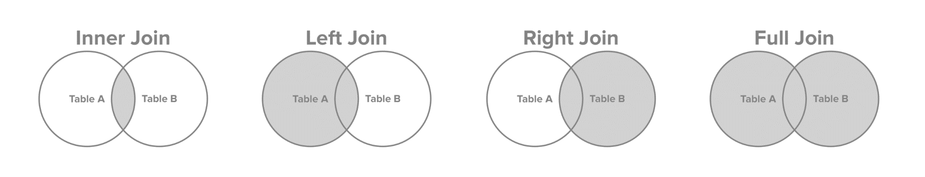
JOINS and SUB-QUERIES
A SQL Join statement is used to combine data or rows from two or more tables based on a common field between them. Different types of Joins are:
INNER JOIN
LEFT JOIN
RIGHT JOIN
FULL JOIN
A Subquery or Inner query or a Nested query is a query within another SQL query and embedded within the WHERE clause.
A subquery is used to return data that will be used in the main query as a condition to further restrict the data to be retrieved.

Slide 6
Exercise – SQL Functions and Joins
Understand the features of built-in ABAP functions. Also explore the JOINS and SUB-QUERIES in the system.
PROGRAM NAME: ZNC_XX_SELECT_ADV

Slide 7
Data Manipulation
Data manipulation language (DML) statements add, change, and delete HANA Database table data.
A transaction is a sequence of one or more SQL statements that HANA Database treats as a unit: either all of the statements are performed, or none of them are.
Following are the commonly used DML Commands
INSERT – to create new records
UPDATE – to change property of existing records
DELETE – to remove records

Slide 8
Exercise – Debugging SQL Code
Understand the SQL Code debugging and also explore system variable sy-dbcnt.

Slide 9

Modularization Techniques
A modularization unit is a like a shell into which you can put code. It allows you to segregate a group of lines of code from the rest, and then execute them at a specific time. The lines of code within a modularization unit act very much like a mini-program that can be called from another program.
ABAP offers below types of modularization units:
Subroutines
Includes
Function modules
Classes
Use modularization units to eliminate redundant code within your program and to make your program easier to read. For example, suppose you have a series of statements that format a mailing address, and you need to format mailing addresses at several different places in your program. Instead of duplicating the code within your program, it's a good idea to place that code into a modularization unit and call it whenever you need to format an address.

Slide 10
Subroutines
Subroutine definitions are usually placed at the end of the program, after all events. The form statement defines the end of the preceding event, and the beginning of a subroutine. Subroutines cannot be nested inside of events.
form s [tables t1 t2 ...]
[using u1 value(u2) ...]
[changing c1 value(c2) ...].
---
endform.
All additions are optional.
When they are coded, additions must appear in the order shown here. If coded, tables must come first, then using, and then changing.
Each addition can only be specified once. For example, the tables addition can only appear once. However, multiple tables can appear after it.
Do not use commas to separate parameters.
tables only allows internal tables to be passed-not database tables.
A subroutine can call another subroutine.
Recursion is supported. A subroutine can call itself or a subroutine that calls it.
Subroutine definitions cannot be nested. (You cannot define a subroutine within another subroutine.)
Syntax for the perform Statement-calling subroutines
perform a) s
b) n of s1 s2 s3 ...
[tables t1 t2 ...]
[using u1 u2 ...]
[changing c1 c2 ...].

Slide 11
Exercise - Subroutines
Understand the process of creating subroutine and calling the same, also we explore how can we pass value or reference variables.
Explore the passing of internal table to the sub-routine.
Program Name: ZNC_XX_SUBROUTINE

Slide 12
Includes
An include program is a program in which the contents are designed to be used by another program. It is not usually complete all by itself. Instead, other programs use the code the include program contains by copying the lines of code from the include program into themselves. The copy is performed at runtime via the include statement. An include program is also known as an included program.
A program that includes another is known as an including program.

Slide 13
Exercise - Include
Create a program which includes other programs
Program Name: ZNC_XX_INCLUDE and ZNC_XX_INC_USE

Slide 14
Function Modules
A function module is one of the four main ABAP modularization units. It has following characteristics
It exist within an external program.
It enable parameters to be passed and returned.
Its Parameters can be passed by value, or by reference.
Function Groups
A function group is a program that contains function modules. With each R/3 system, SAP supplies more than 8,000 pre-existing function groups. In total, they contain more than 42,000 function modules. If the functionality you require is not already covered by these SAP-supplied function modules, you can also create your own function groups and function modules
When you create a Function Group, and if it doesn't yet exist, the system creates:
A main program
A top include
A UXX include
A function module include

Slide 15
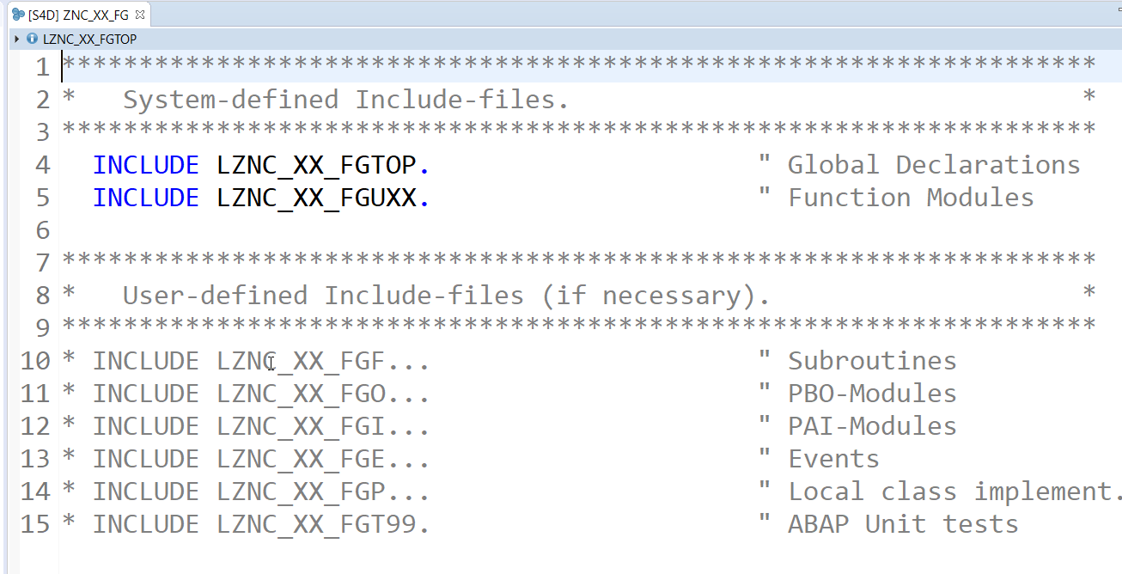
Exercise - Function Group
Create a new function group with name ZNC_XX_FG and observe the INCLUDEs inside.

Slide 16
Exercise - Function Module
Create simple function module to
Divide two numbers – ZNC_XX_DIVIDE
Read business partner data by passing country - ZNC_XX_READ_BP_BY_CTRY
Create business partner address record - ZNC_XX_CREATE_BP_ADDR
Create a business partner - ZNC_XX_CREATE_BP
Program to consume the FMs
ZNC_XX_CALL_FM

Slide 17

Break

Slide 18
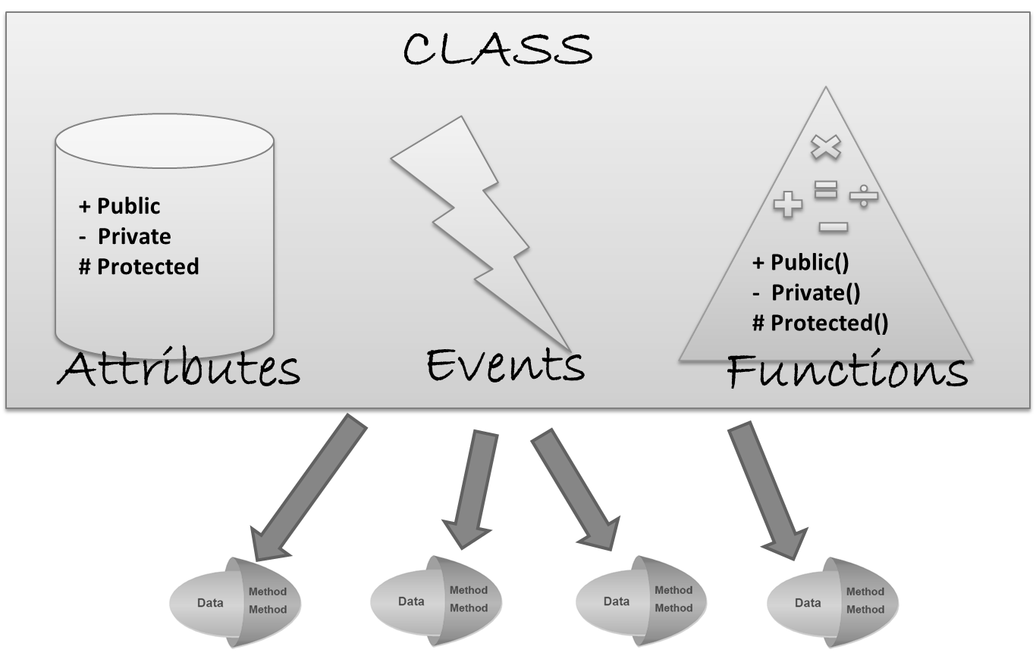
Introduction to Classes
Class is a template which represents a real-world entity e.g. ball, cap, plane, home, person.
A Class
has
Attributes/properties
Functions/behaviors
Events
produce
Objects
Visibility of attr./functions are
Public
Private
Protected

Slide 19
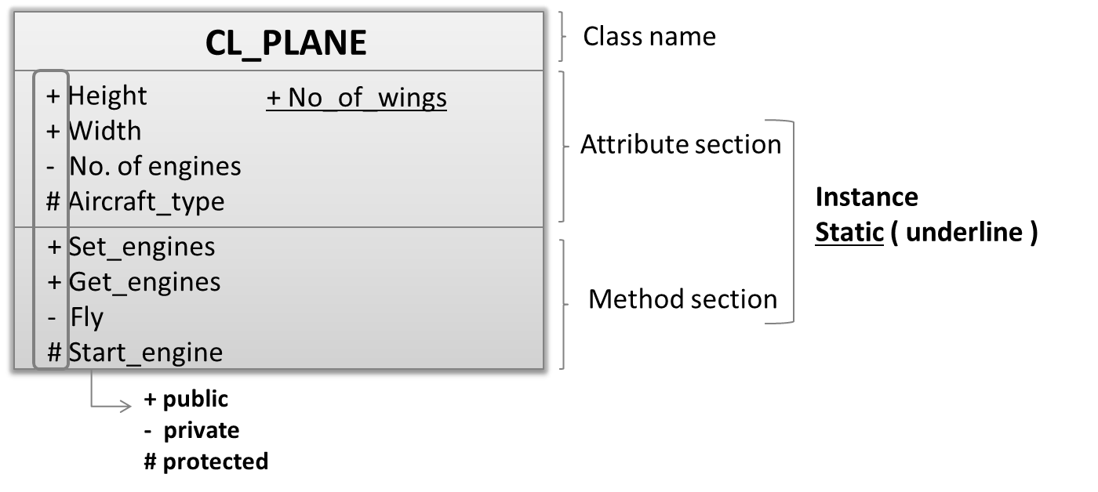
UML Representation

Slide 20



Plane

Slide 21
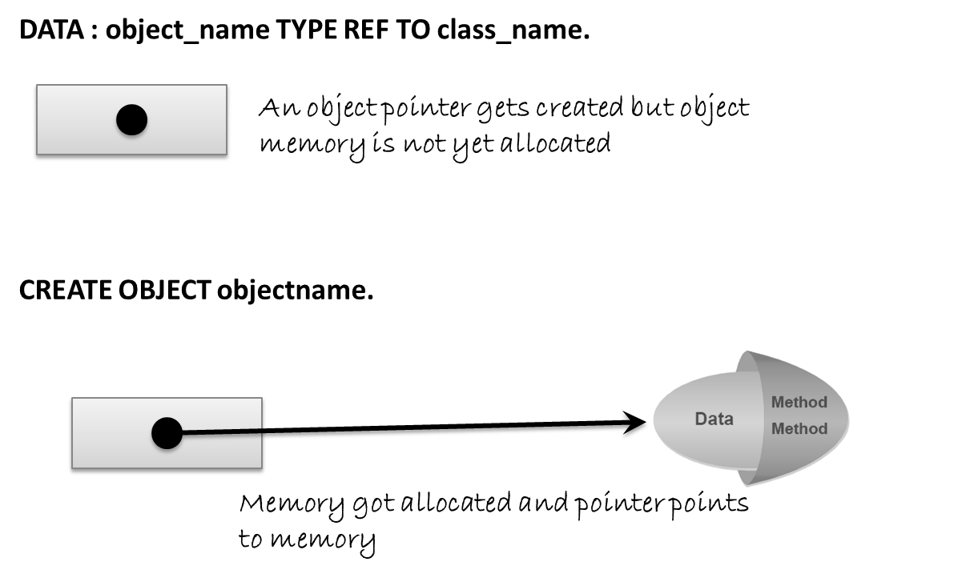
Working with class objects

Slide 22
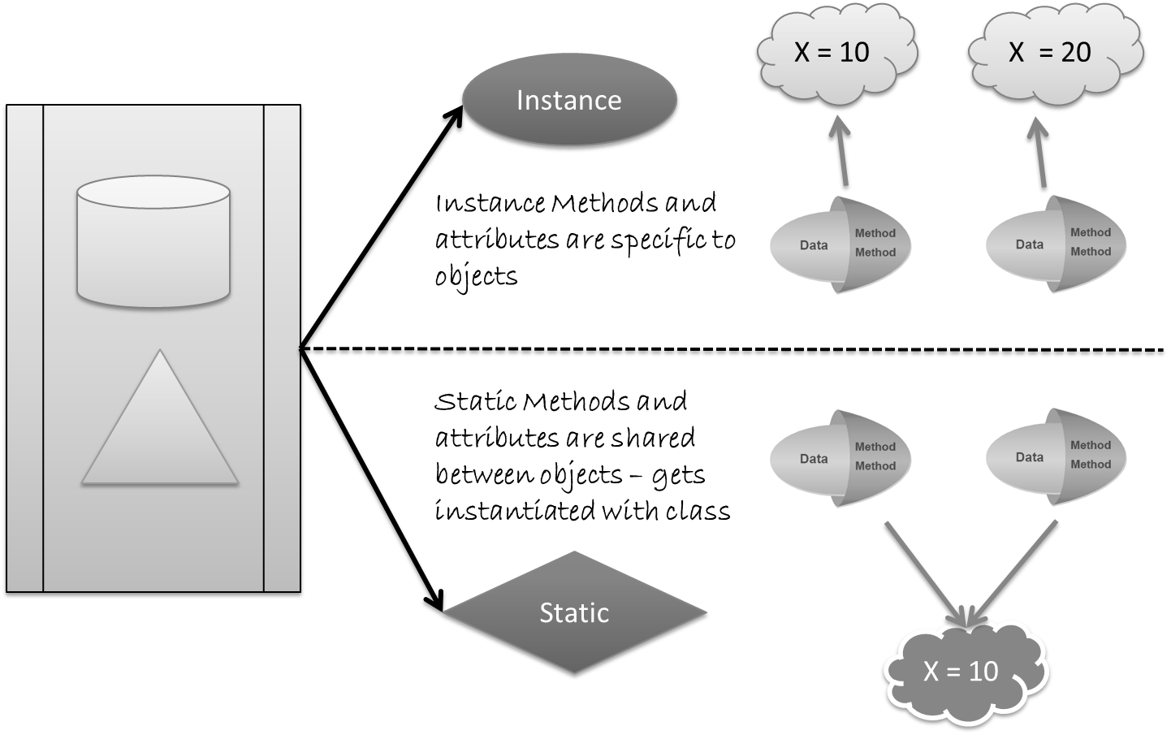
Each object is different

Slide 23
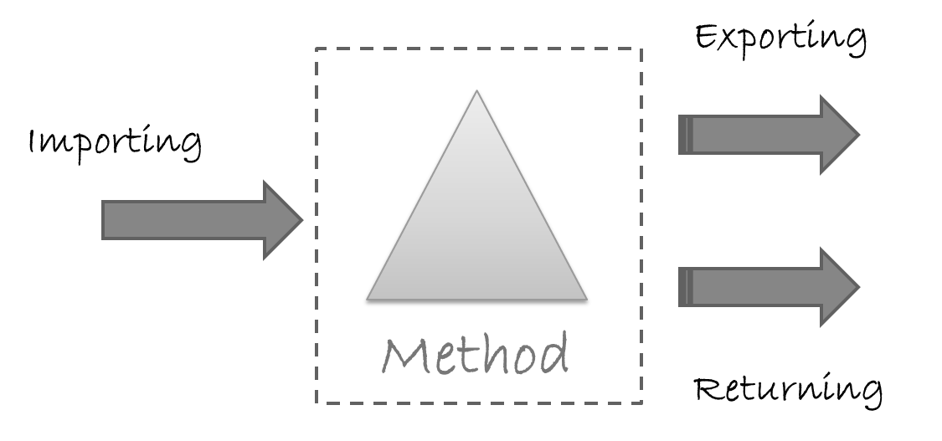
A Class method

Slide 24
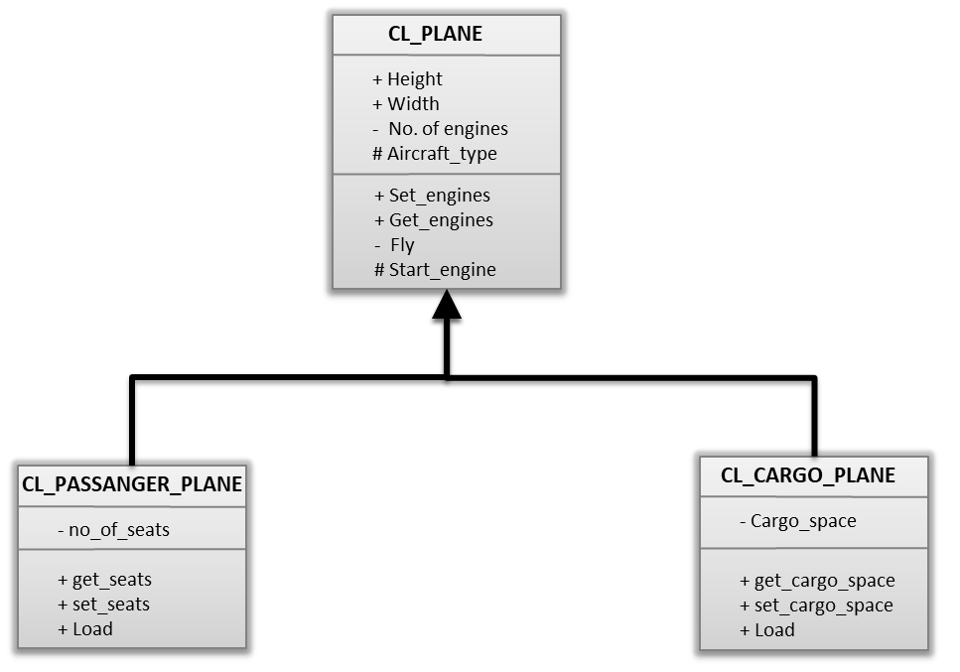
Exercise – Create Class
Create a simple plane class
Name: ZCL_XX_PLANE
Test Program: ZNC_XX_CLASS_CONSUME

Slide 25
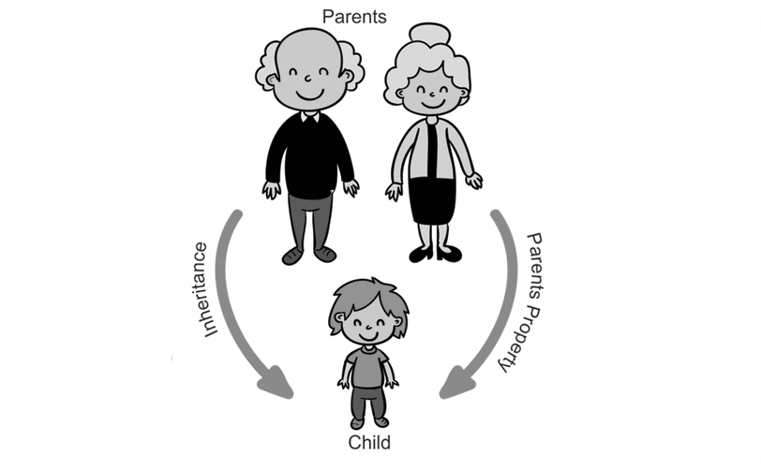
Inheritance

Slide 26
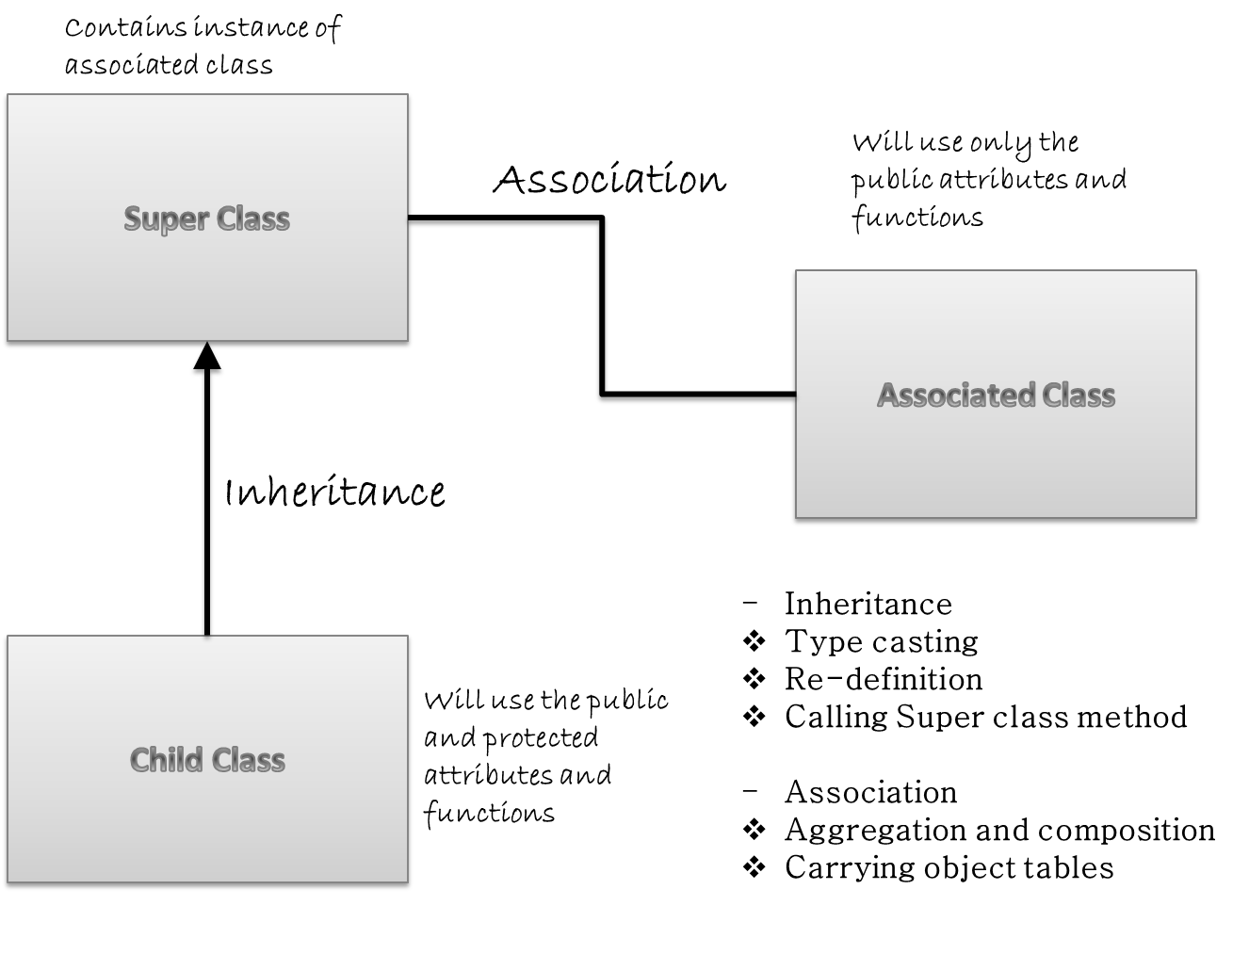
Class Relations – Inheritance and Associations

Slide 27
Exercise – Inheritance
Extend the last example of plane class with inheritance
Add 2 child classes (sub-classes) passenger and cargo plane
Add attributes and functions to the child classes
Create program to consume these classes
Child Class Names: ZCL_XX_PASS_PLANE
ZCL_XX_CARGO_PLANE

Slide 28
Right click on passenger plane and choose Copy
Enter the name as ZCL_XX_CARGO_PLANE
Go to attributes and rename seats to cargo_space
Go to method parameters and rename i_seats and e_seats to i_cargo and e_cargo
Inside the code of each method change the variables.
Activate the cargo plane
method SET_CARGO. me->cargo_space = i_cargo. endmethod.
method GET_CARGO. e_cargo = me->cargo_space. endmethod.

Slide 29
Aggregation and Composition
Associations are of 2 types
Aggregation – is a lose coupling / both objects can operate independently / good to have relationship / represent using empty rhombus
Composition - is a tight coupling / both objects cannot operate independently / must to have relationship / represent using empty rhombus

Slide 30
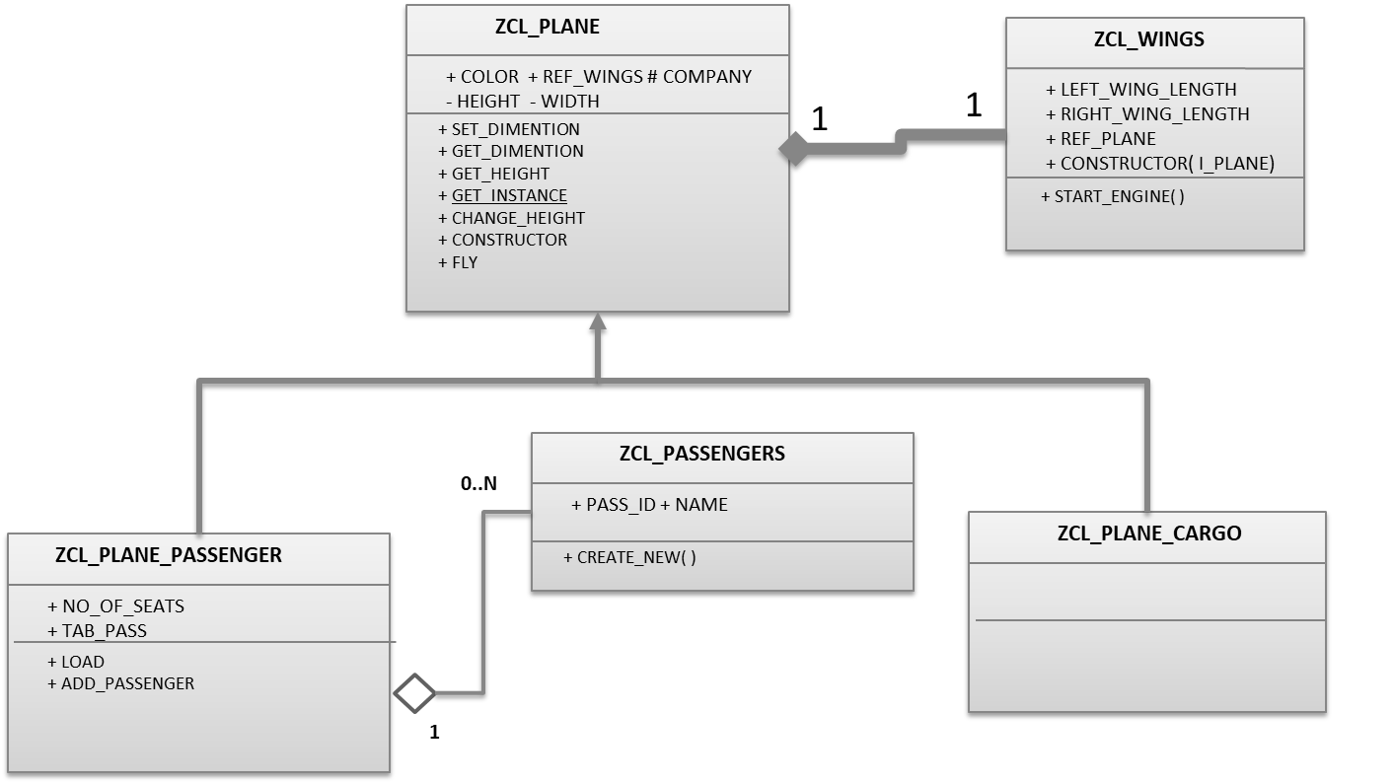
Exercise – Aggregation & Composition
Implement the Aggregation
Create a new Passenger class ZCL_XX_PASSENGER
Add object of passengers to Passenger to PASS_PLANE
Implement the Composition
Create a new Wings class ZCL_XX_WINGS
Add object of Cargo to Plane as composition

Slide 31
<Title>
<content>

Slide 32
<Title>
<content>

Slide 33
End of Day 4

Slide 34

Questions

Slide 35

Anubhav Oberoy

